Slide 1
European Debt Crisis
Year 2011

Slide 2
Overview
So as we remember, Europe had that whole situation where a lot of countries owed each other money and they were on the verge of bankruptcy. So that was all back starting from 2008, to 2011 and onwards.
The debt crisis in Europe did not only affect the region, but many other economies were affected especially the U.S whose large multinational companies have vast interest in the European market.

Slide 3
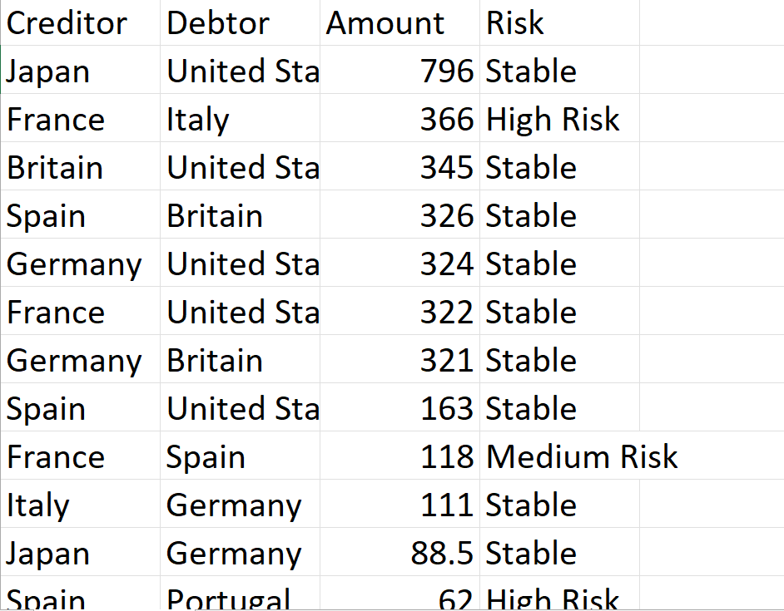
Dataset in Excel
So nothing too major here, we've got the creditors, so of the country that lent money to another country.
And then here we've got the country that the money was lent to.
Then amount- this amount is in.
Billions of dollars.

Slide 4
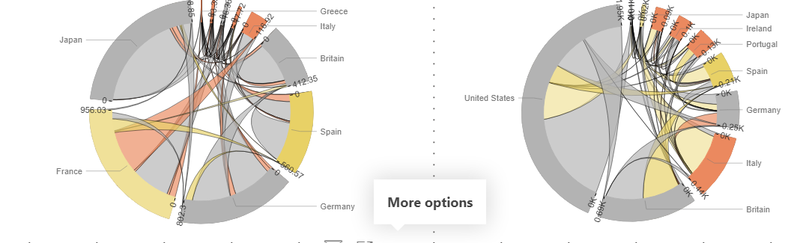
Chord Diagram
In Power BI we will use chord Diagram for Data Visualization and for finding patterns.
Chord diagrams show directed relationships among a group of entities using colored lines (chords); this allows for an easy representation of correlating data.

Slide 5
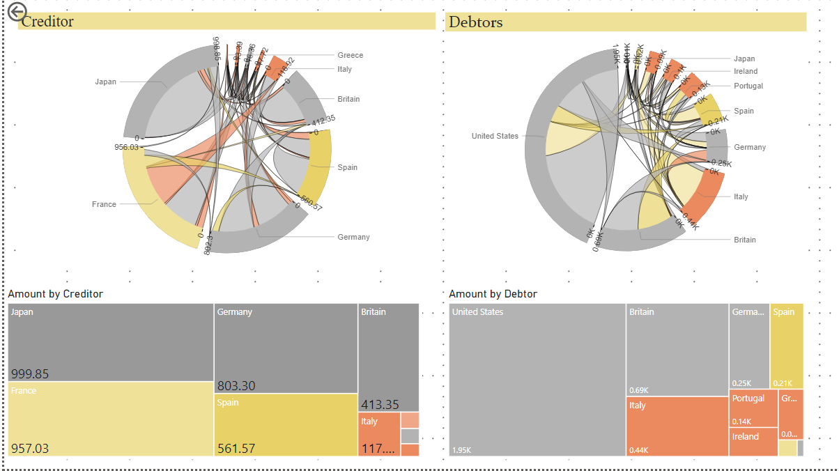

Understanding the Analysis
Stable
Medium
Risk
Low Risk
High
risk

Slide 6
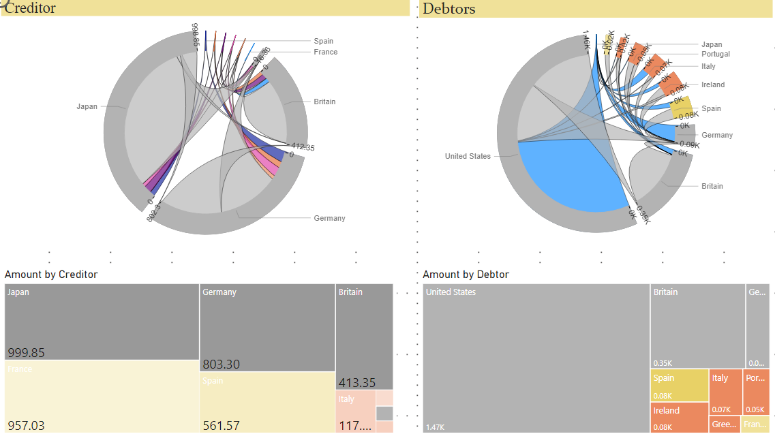
Exploring the Visualization
First of all, we're going to look at who are the most stable countries lending money to.
because of the sizes of these parts of the pies, we can tell that the most lending is actually being done by Japan, Germany and Britain.
And we can also tell that from the, , we can say, see that the US didn't do much lending at all.
And the interesting thing is that these countries tend to lend money to each other.
So Japan lent United States seven hundred and eighty six billion, Germany lent them 324 billion and
Britain lent them 345 billion dollars.

Slide 7
And on the right we can see who are the countries that are actually borrowing money.
And here we're going to be looking at how much countries are borrowing from these four countries.
So the highest borrower by far is the United States in total, one point four trillion dollars.
Then we've got Britain and Germany.
So we can see that the United States is by far the highest borrower.
most of the money for the United States is coming from Japan, 796 thousand dollar.

Slide 8
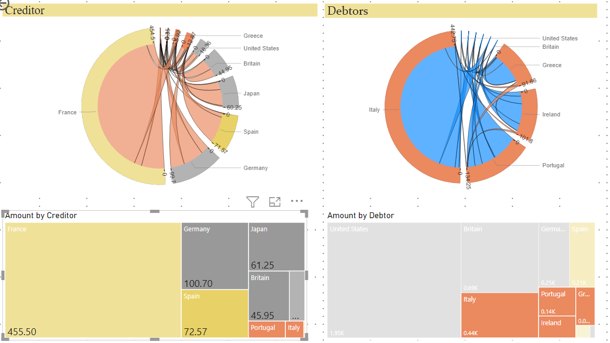
Most riskiest countries
So Power Bi set to Italy, Portugal, Ireland and Greece.
And let's see where they're borrowing money from
So here we can see Italy owes the most one hundred and forty three billion dollars.
And most of that money is owed to France by Italy. And then also a bit is owed to Britain.
Italy also always Japan, 38 billion dollars and Italy owes the United States 3.16 dollars billion.
Then comes Portugal, then Ireland, then Greece.

Slide 9
And now where are they borrowing this money from?
All of these four countries are the most riskiest.
The biggest creditor for them is France.
It's not Japan or the US or one of these stable countries.
So France has lent these countries and we can see here most of that money is probably gone to Italy,
366 billion dollars.
France also made a quite a substantial loan to Greece, which we, as we know, was one of
the least, stable countries or the most riskiest countries at the time.

Slide 10
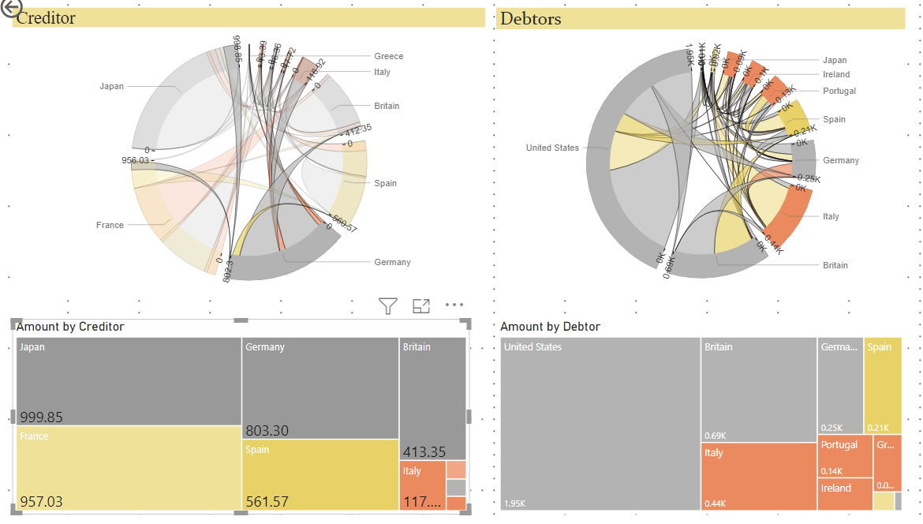
GERMANY
Lets analysis Germany as Creditor
Germany lent money to Britain 321 billion.
Germany lend Ireland and Spain some money.
Germany lend United stated hug amount of money 324 billion dollar.
Spain owes Germany 557.6 billion.

